Slide 1
Project-3 Retail Large Dataset Analysis NextHikes Solutions By - Rakshit A Solanki

Slide 2
Project Overview
This project is based on analyzing retail sales data to understand how different factors affect business performance.
The main focus is on identifying patterns in sales, Pricing & Customer behaviour.
The analysis includes Product price, Final price, Quantity, Discount & Customer segment.
This project shows how data analysis can help businesses make better and smarter decision.

Slide 3
Project Objective
Sales data Analysis
The main objective of this project is to study how sales are happening and what factors are affecting them.
It helps in identifying important trends and patterns in the data.
Identify Patterns
The project focuses on finding relationship between variables such as Price, Quantity & Category.
This helps in understanding customer buying behavior more clearly.
Business improvement
The insights generated from the analysis can be used to improve business strategies and make better decision in the future.

Slide 4
Data Cleaning
Missing Values
The dataset was checked for missing values and it was mostly clean.
No major issues were found in the data.
Date Conversion
The date column was converted into datetime format.
This helps in performing time based analysis.
Data Preparation
After cleaning the dataset was ready for analysis.
This step ensures accurate results.

Slide 5
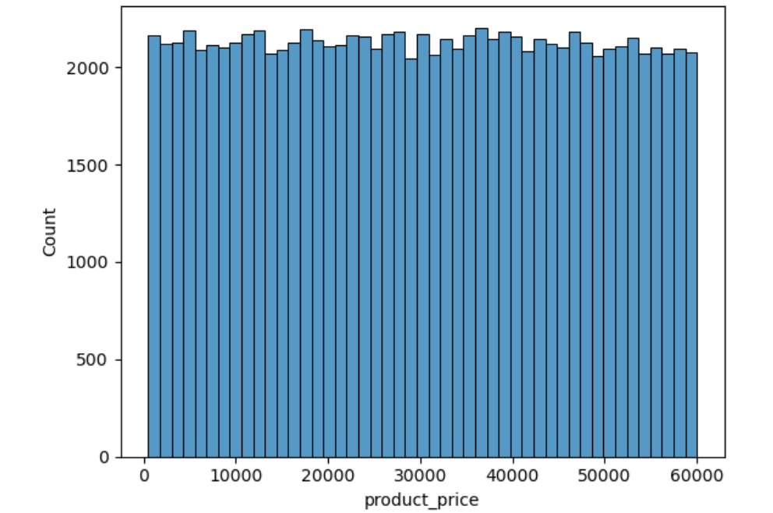
Univariate Analysis
Product Price Distribution
The histogram shows that most products are concentrated in the mid price range.
Very few products are present in the higher price range.
The distribution is slightly uneven & showing variation in pricing across products.
This visualization helps in identifying common price ranges and overall pricing pattern.

Slide 6
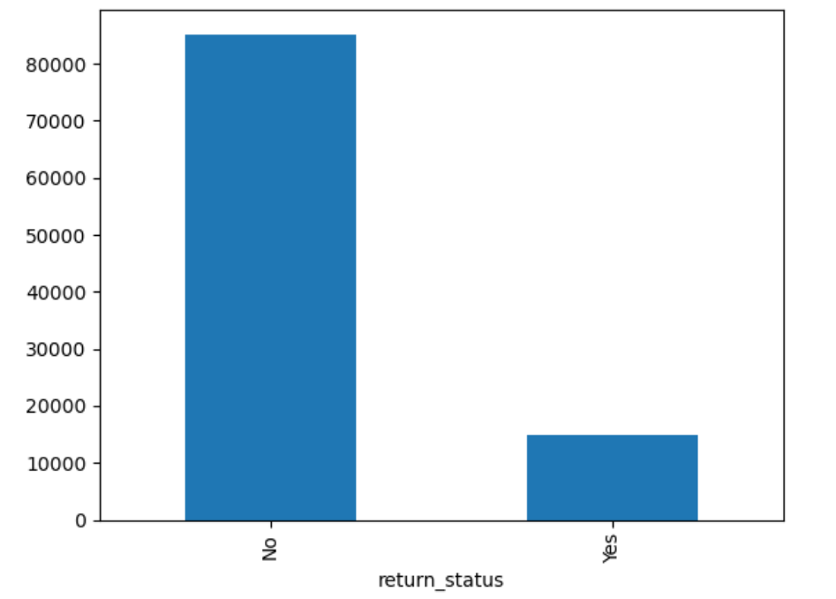
Univariate Analysis
Return Status Analysis
The chart clearly shows that the number of non returned products is significantly higher than returned products.
Only a small portion of products fall under the returned category.
Returned products may represents issues related to product quality, deliver or customer expectations.
This analysis helps in reducing losses and improving services.

Slide 7
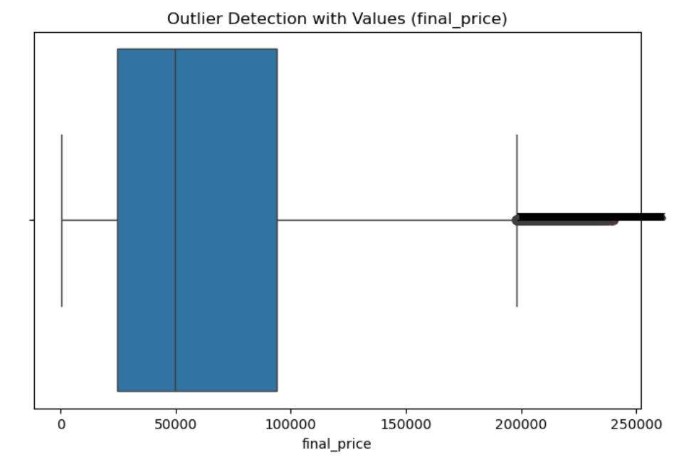
Univariate Analysis
Outlier Detection
The box plot shows the overall distribution of final price values along with the median and spread.
Lower and upper bounds are calculated using IQR method to identify extreme values.
Most of the data lies within the defined range while only few values fall outside.
These extreme values may represent very high priced products or unusual transactions.

Slide 8
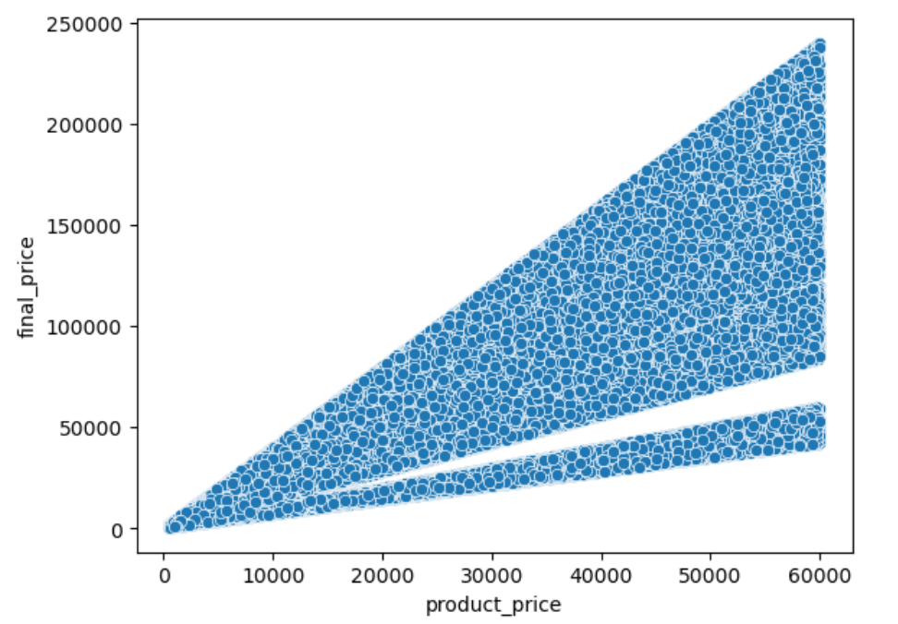
Bivariate Analysis
Product Price & Final Price
The scatter plot shows a clear upward trend & indicating a strong positive relationship between the two variables.
Most data points are closely aligned which shows that final price generally follows the original product price.
Some variations in points indicates the presence of discounts applied to products.
This visualization helps in understanding how pricing and discount strategies are applied across products.

Slide 9
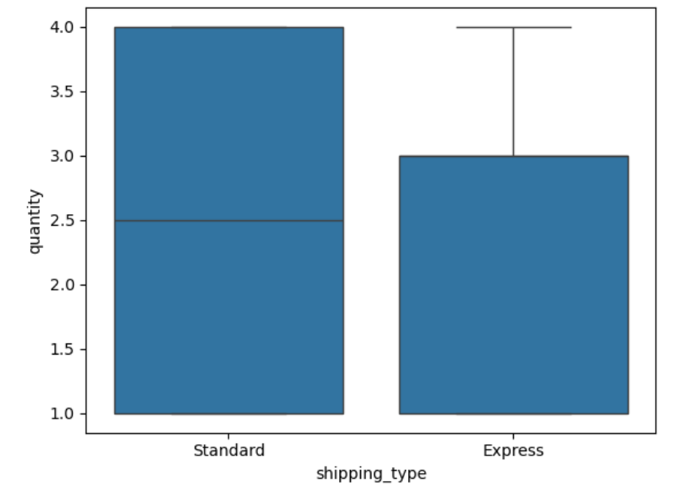
Bivariate Analysis
Shipping Types & Delivery days
The chart shows that some shipping types are used more frequently compared to others.
A higher count in certain shipping methods indicates customer preference for those points.
The variation in distribution highlights differences in delivery choices among customers.
This visualization helps in identifying the most efficient & commonly used shipping methods.

Slide 10
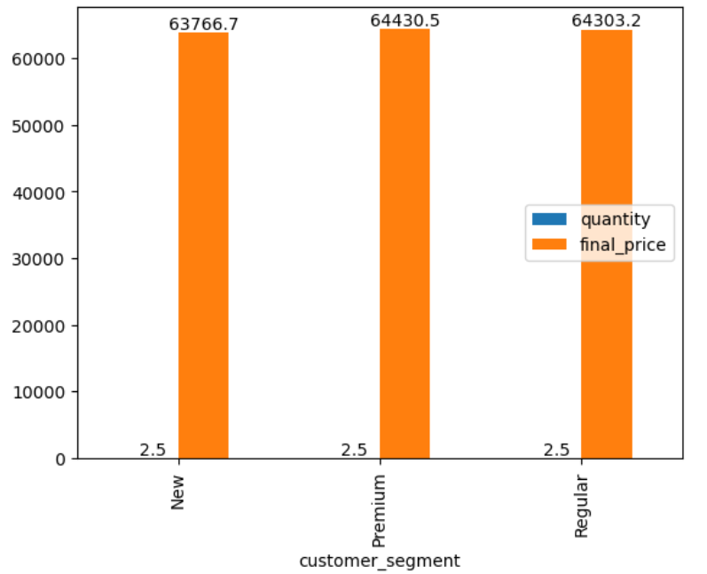
Multivariate Analysis
Customer Segment Analysis
The chart shows that different customer segments have varying contributions to total sales.
Some segments have higher values & indicating customers with greater spending capacity.
Lower segments represent customer with less frequent or lower value purchases.
This visualization helps in identifying high value customers and targeting them effectively.

Slide 11
Skewness & Kurtosis
Skewness Analysis
The skewness value shows that data is slightly shifted to one side.
Most values are present in a particular range.
Only few values are spread towards the extreme side.
Kurtosis Analysis
The kurtosis value shows that most product prices are grouped in a certain range.
At the same time some products have very high or very low prices compared to others.
This shows the pricing is not completely uniform across all products.

Slide 12
Key Observation
Analysis shows that product prices follow a particular pattern with most values in a fixed range.
Some product categories have higher number of products and better performance compared to others.
Customer segments show different buying behavior based on their activity and contribution.
A few extreme values are observed in price and quantity which affect the overall data distribution.
Return data indicates that majority of products are not returned by customers.

Slide 13
Business Insights
Product pricing has a direct impact on demand as most customer prefer products in a certain price range.
Analysis shows that different customer segments behave differently in terms of purchasing and spending.
Some product categories perform better and contribute more to overall sales.
Return analysis indicates that most products meet customer expectations.
Variation in pricing and sales show that not all products perform equally.

Slide 14
Challenges Faced During Analysis Data
Different columns had different data types so formatting and conversion was required before analysis.
Date column needed to be converted into proper format for time based analysis.
While creating charts it was important to check whether the visualization was correctly representing the data.
Some variations and extreme values made the analysis slightly complex.
Multiple checks were required at different steps to ensure the accuracy of results.

Slide 15
Conclusion
The project helped in analyzing retail data and understanding how different factors affect sales and pricing.
Visualization helped in clearly understanding the distribution and relationship in the data.
Some variation and extreme values were also identified during the analysis project.
Overall the project shows how data analysis can be useful in improving business decision and performance.

Slide 16
Reference Links Used For Learn
https://www.geeksforgeeks.org/data-analysis/eda-with-numpy-pandas-matplotlib-seaborn/
https://pandas.pydata.org/docs/
https://numpy.org/doc/
https://seaborn.pydata.org/
https://matplotlib.org/stable/

Slide 17
Thank You

